Slide 1
C programming

Slide 2
Question
Explain modular programming. Explain user defined function in c.

Slide 3
What is modular programming??
Modular programming
Subdividing the program into sub programs or modules
Module is separate software component /function
Enables multiple programmers to divide up the work and debug pieces of the program
Module is divided into an interface and implementation
The implementation is hidden and private
Separate functions developed as separate codes-reusal by other applications

Slide 4
User defined function
C allows programmer to define their own function according to their requirement. These types of functions are known as user-defined functions.
Every function in C programming should be declared before they are used. These type of declaration are also called function prototype. Function prototype gives compiler information about function name, type of arguments to be passed and return type.

Slide 5
User defined function
For better understanding of arguments and return type in functions, user-defined functions can be categorized as:
Function with no arguments and no return value
Function with no arguments and return value
Function with arguments but no return value
Function with arguments and return value.

Slide 6
Function with no arguments and no return value
void prime();
int main()
{ prime();
//No argument is passed to prime().
return 0;
}
void prime()
{ /* There is no return value to calling function main(). Hence, return type of prime() is void */
int num,i,flag=0;
printf("Enter positive integer enter to check:\n");

Slide 7
Function with no arguments and no return value
scanf("%d",&num);
for(i=2;i<=num/2;++i)
{ if(num%i==0)
{
flag=1;
break;
}
}
if (flag==1)
printf("%d is not prime",num);
else
printf("%d is prime",num);
}

Slide 8
Function with no arguments but return value
#include <stdio.h>
int input();
int main()
{ int num,i,flag = 0;
num=input();
/* No argument is passed to input() */
for(i=2; i<=num/2; ++i)
{ if(num%i==0)
{ flag = 1;
break;
}
}

Slide 9
Function with no arguments but return value
if(flag == 1)
printf("%d is not prime",num);
else
printf("%d is prime", num);
return 0;
}
int input()
{ /* Integer value is returned from input() to calling function */
int n;
printf("Enter positive integer to check:\n");

Slide 10
Function with no arguments but return value
scanf("%d",&n);
return n;
}

Slide 11
Function with arguments and no return value
#include <stdio.h>
void check_display(int n);
int main()
{ int num;
printf("Enter positive enter to check:\n");
scanf("%d",&num);
check_display(num);
/* Argument num is passed to function. */
return 0;
}

Slide 12
Function with arguments and no return value
void check_display(int n)
{ /* There is no return value to calling function.
Hence, return type of function is void. */
int i, flag = 0;
for(i=2; i<=n/2; ++i)
{
if(n%i==0)
{ flag = 1;
break;
}
}

Slide 13
Function with arguments and no return value
if(flag == 1)
printf("%d is not prime",n);
else
printf("%d is prime", n);
}

Slide 14
Function with argument and a return value
#include <stdio.h>
int check(int n);
int main()
{ int num,num_check=0;
printf("Enter positive enter to check:\n");
scanf("%d",&num);
num_check=check(num);
/* Argument num is passed to check() function. */
if(num_check==1)
printf("%d is not prime",num);

Slide 15
Function with argument and a return value
else
printf("%d is prime",num);
return 0;
}
int check(int n)
{ /* Integer value is returned from function check() */
int i;
for(i=2;i<=n/2;++i)
{ if(n%i==0)
return 1;

Slide 16
Function with argument and a return value
}
return 0;
}

Slide 17
Question
write c program to use the function:
numpalindrome(int) that receives a number and checks if the number is a palindrome. The numpalindrome checks if the reverse of the given number is the same.
isvowel(char*) that receives a string and counts the number of vowels in a string.

Slide 18
#include<stdio.h>
void numpalindrome(int);
void isvowel(char *);
void main()
{
int x;
char str[100];
printf("\n Enter the no. to check for palindrome:");
scanf("%d",&x);
numpalindrome(x);
printf("\n Enter the string:");
scanf("%*c%[^\n]s",str);
printf("\n %s",str);
printf("\n No. of vowels: ");
isvowel(str);
}

Slide 19
void numpalindrome(int x)
{
int temp,z=0,y=0;
temp=x;
while(temp!=0)
{
y=temp%10;
z=z*10+y;
temp/=10;
}
if(z==x)
printf("\n Palindrome");
else
printf("\n Not a palindrome");
}

Slide 20
void isvowel(char *str)
{
int i,count=0;
for(i=0;str[i]!='\0';++i)
{
str[i]=tolower(str[i]);
if(str[i]=='a'||str[i]=='e'||str[i]=='i'||str[i]=='o'||str[i]=='u')
{
count++;
}
}
printf("%d",count);
}

Slide 21
Algorithm
1)Start
2)Get the following inputs from the user
i)height in inches
ii)weight in pounds
iii)sex (male / female)
iv)ch
3)Convert height and weight to metres and kilograms respectively and calculate bmi
4)If sex is male goto step 6 and if sex is female goto step 5
5)Ask whether the user is pregnant
i)if yes bmi cannot be calculated
ii)if no if the bmi is greater than or equal to 27.3 then the user is obese else the user is not obese
6)if bmi is greater than or equal to 27.8 then the user is obese else the user is not obese
7)end

Slide 22
Flow chart
start
Get the inputs from the user ht,wt,sex
Convert ht from inches to metres
Convert wt from pounds to kilogram
Calculate bmi
A

Slide 23
N
A
If sex is male
Y
if bmi is greater than or equal to 27.8 then the user is obese else not obese
If sex is female
Get the input whether the user is pregnant
Y
N
exit
Y
N
Y
Sorry cannot calculate BMI
If bmi is greater than or equal to 27.3 then the user is obese else not obese

Slide 24
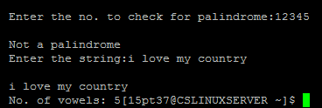
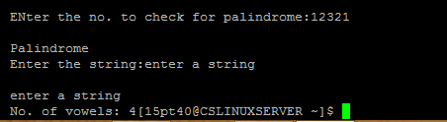
Output
Output 1:
Output 2:

Slide 25
Question
Explain storage classes in c.

Slide 26
Storage classes
A storage class defines the scope (visibility) and lifetime of variables and/or functions within a C program.
There are four storage classes in c:
a)Automatic storage class
b)Register storage class
c)Static storage class
d)Extern storage class

Slide 27
Automatic storage class
It defines local variables which are known to the block in which they are defined.
It is the default storage class for all local variables.
#include<stdio.h>
void main()
{
auto int i=1;
{
auto int i=2;
{
int i=3;
printf(“%d”,i);
}
printf(“%d”,i);
}
printf(“%d”,i);
}
Output: 321

Slide 28
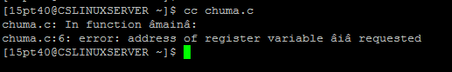
Register storage class
The register storage class instructs the compiler to store the variable in the CPU’s register to optimize access.
It is used for frequently used variables such as loop counters
int main()
{
register int i;
for(i=1;i<=10;i++)
printf(“%d\n”,i);
}
#include<stdio.h>
void main()
{
register int i;
scanf("%d",&i);
}

Slide 29
Static storage class
The static storage class allows the variable to exist in the memory of the computer, even if its function or block within which it is declared looses its scope.
Hence the variable also retains the last assigned value.

Slide 30
#include<stdio.h>
void increment()
int main()
{
increment();
increment();
increment();
}
void increment()
{
int i=1;
printf(“%d\t”,i);
i++;
}
Output: 1 1 1
#include<stdio.h>
void increment()
int main()
{
increment();
increment();
increment();
}
void increment()
{
static int i=1;
printf(“%d\t”,i);
i++;
}
Output: 1 2 3

Slide 31
Extern storage class
The extern storage class defines global variable known to all functions in the current program.
These variables are defined in another program.
#include<stdio.h>
extern void write();
main()
{
count=5;
write();
}
#include<stdio.h>
extern int count;
void write()
{
printf(“count is %d\n”,count);
}
Output:5

Slide 32
 | Storage | Default initial value | Scope | Life
Auto | Memory | Garbage value | Block | Till the control remains within the block in which the variable is defined.
Register | CPU Registers | Garbage value | Block | Till the control remains within the block in which the variable is defined.
Static | Memory | Zero | Block | Value of the variable persists between different function calls.
Extern | Memory | Zero | Global | As long as the program’s execution doesn’t come to an end.

Slide 33
Question
The US CDC(centre for disease control) determine obesity according to Body Mass Index computed by the formula:
Index=(weight in kilograms)/(height in meters)
An index of 27.8 or greater for men or 27.3 or greater for non pregnant women is considered obese. Write a program that prompts for weight , height and sex and determine whether the user is obese or not. Write a function that returns the BMI given the height and weight in inches and pounds.
(note that:1m=39.37 inches
1 inch=2.54 cm
1 kg=2.2 pounds
1 pound =454 gm)

Slide 34
#include<stdio.h>
#include<math.h>
float BMI(float ,float);
void main()
{
float bmi;
float ht,wt;
char ch,sex;
printf("\n Enter the height in inches:");
scanf("%f",&ht);
printf("\n Enter the weight in pounds:");
scanf("%f",&wt);
printf("\n Enter the gender('M' or 'F'):");
scanf("%c%c",&sex);
ht=(float)(ht)/39.37;
wt=(float)(wt)/2.2;

Slide 35
bmi=BMI(ht,wt);
sex=toupper(sex);printf("\n the BMI is:%f",bmi);
if(sex=='M')
{
if(bmi>=27.8)
printf("\n OBESE");
else
printf("\n NOT OBESE");
}
if(sex=='F')
{ printf("\n R U pregnant?");
scanf("%c%c",&ch);
ch=toupper(ch);
if(ch=='N')
{

Slide 36
if(bmi>=27.3)
printf("\n OBESE");
else
printf("\n Not obese");
}
else
printf("\n Sorry BMI cannot be calculated!!!!");
}
}
float BMI(float ht,float wt)
{
return(wt/(pow(ht,2)));
}

Slide 37
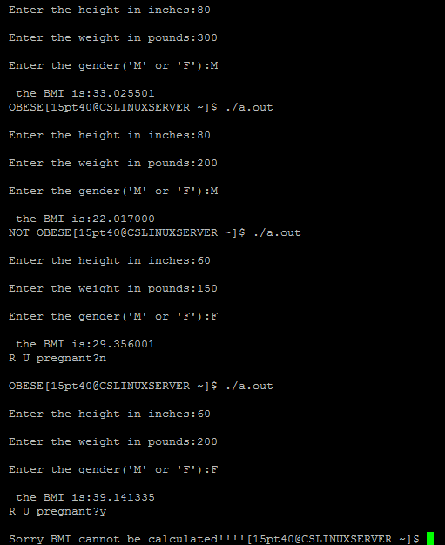
output

Slide 38
Question
Classify the different types of programming errors. A Program has been compiled and linked sucessfully. When you run this program you face one or more of the following situations:
program executed but no output
It produces incorrect answers
It does not stop running
What are the possible causes in each case and what steps would you take to correct them??

Slide 39
Types of errors
Compile-time errors
Runtime errors
Logical errors

Slide 40
Compilation Errors
During the compilation time of the program
Classification:
- Syntax errors
- Semantic errors
-Linker error

Slide 41
Syntax Errors
Rules to be followed
Examples:
- int a: //Semicolon(;) should be used
- Improper formats for loop and sequential structures
- Unmatched parenthesis, braces, square brackets.
etc…

Slide 42
Semantic Errors
Meaning is not correct.
Examples:
- a+b=c; //c=a+b is correct

Slide 43
Linker error
When the linker is unable to find the function code for the function call
Caused misspelling the function name or not including the header file

Slide 44
Runtime Errors
During the runtime of the program
Examples:
- Dividing by zero
-segmentation fault

Slide 45
Logical Errors
Undesired output
Examples:
Ouputs the product instead of the sum.
Displaying wrong message.

Slide 46
It produces incorrect answers
-logical errors
It does not stop running
-if there is an infinite loop or and goto statement that causes the statements to be repeated again and again.

